Slide 1
ALGO TRADE when rocket scientists found second lives on Wall Street
Naikuan Huang, PhD
SEVP, Taiwan Futures Exchange
May 19 2012

Slide 2
PREAMBLE
at a turning point of history
Nature of technological advances
Fairness and order of financial markets
Under-regulation and over-regulation

Slide 3
A Brave New World
From Atomic Bomb to Algorithmic Trade
Changes of Industrial Policy and International Relations
Shortening Impact Time of Information on Prices
A New Form of Arms Race
Market Overview
Landscape
Algo Trading
Impact
Reaction from regulators and market participants
Facilitating
Regulating
Taiwan markets
Opportunities
Challenges
The Way Forward

Slide 4
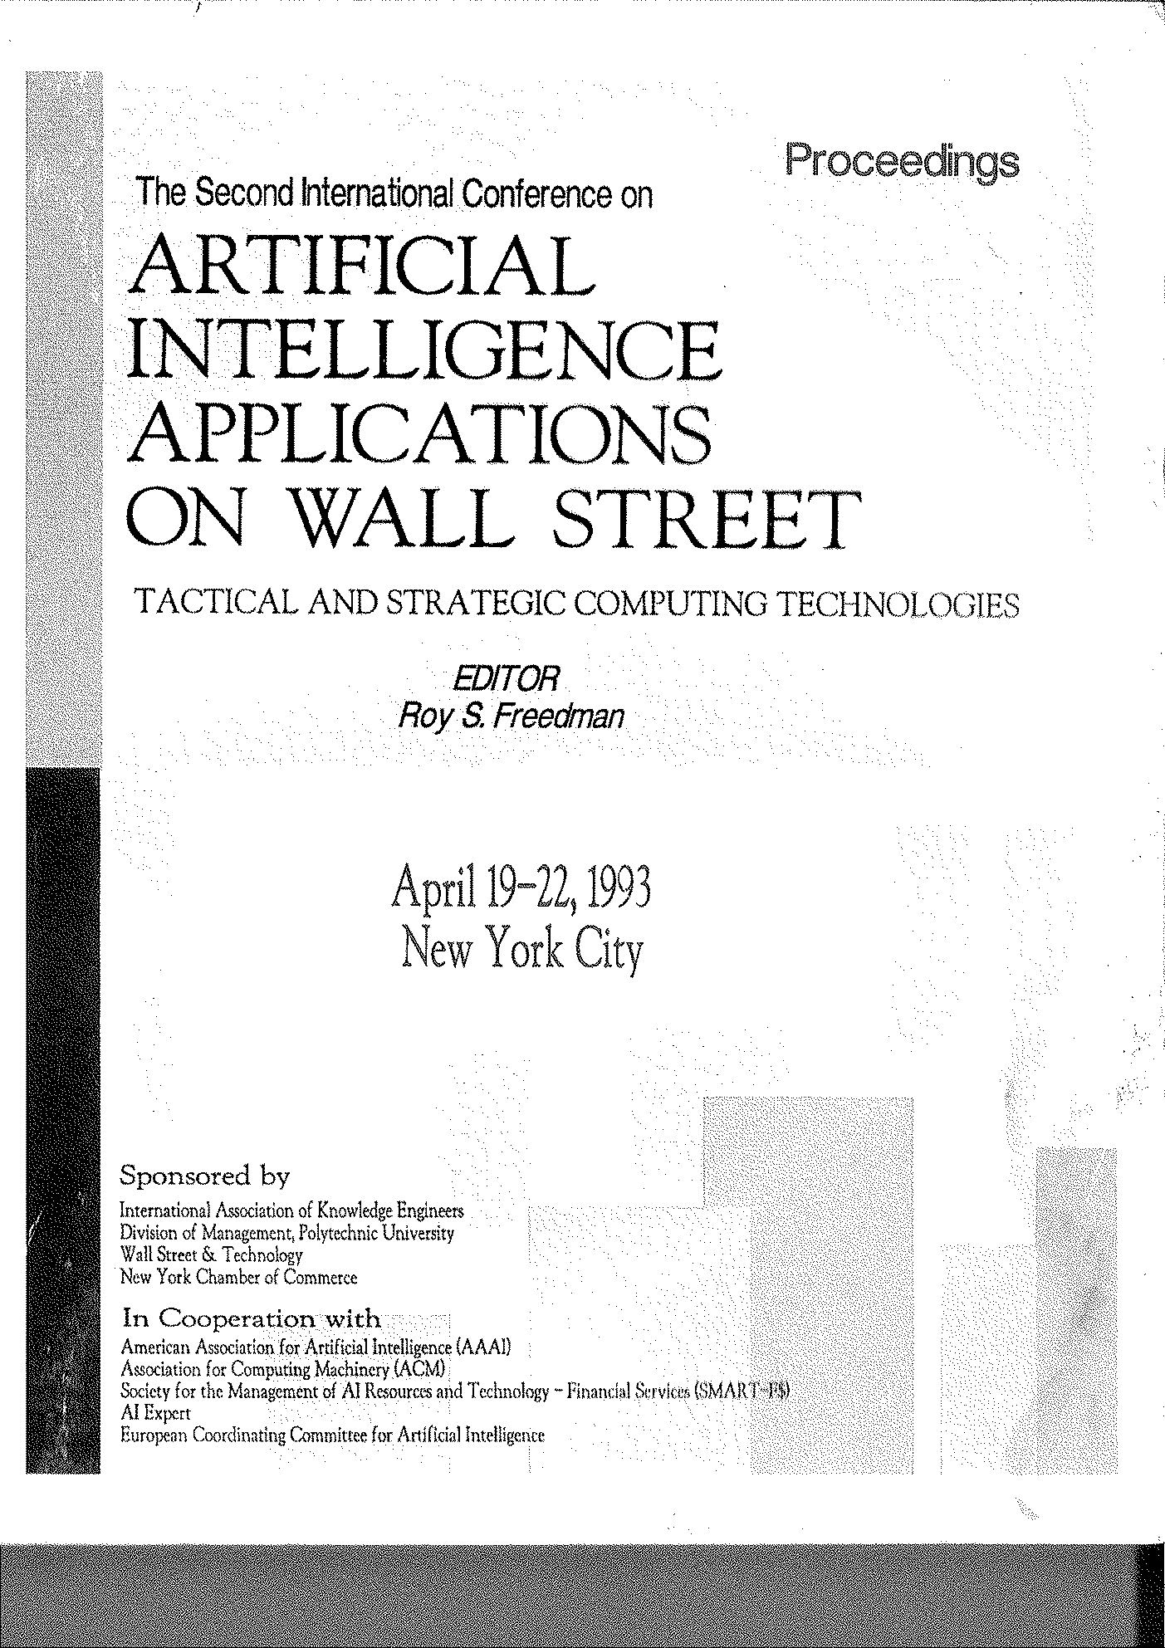

Slide 5
At the crossroad of two industries
What were in common
Clear objective functions
Limited resource allocation
Critical decisions in high uncertainty
Time varying system parameters
Damage control
And not so in common
Cost-benefit analysis (value vs price)
Self control (when to launch it?)
System of systems (we know what we’re doing)

Slide 6
A Brave New World
From Atomic Bomb to Algorithmic Trade
Changes of Industrial Policy and International Relations
Shortening Impact Time of Information on Prices
A New Form of Arms Race
Market Overview
Landscape
Algo Trading
Impact
Reaction from regulators and market participants
Facilitating
Regulating
Taiwan markets
Opportunities
Challenges
The Way Forward

Slide 7
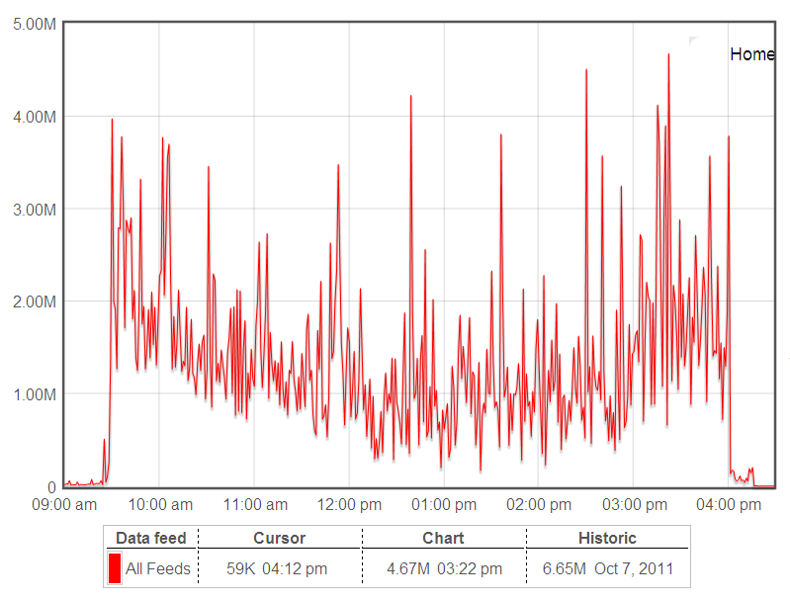
US Market today, with explosive traffic
Market data traffic statistic of May 8, 2012 from www.marketdatapeaks.com
The biggest portion of these market data comes from OPRA, Options Price Reporting Authority

Slide 8
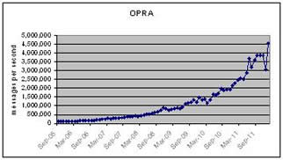
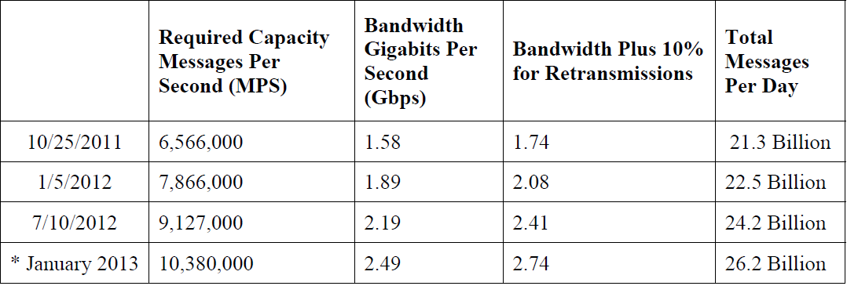
OPRA growth chart
OPRA is the consolidated tape of all US options markets
Chart quoted from http://low-latency.com/blog/market-data-capacity-2011-review-and-2012-outlook
Traffic Projection quoted from www.opradata.com/specs/2012_2013_Updated_Traffic_Projections.pdf

Slide 9
Key Evolving Driver
Regulatory changes lead to competition
Regulation NMS, SEC USA
MiFID, EU
Development and adoption of new automated trading technique
Algorithmic Trading/High Frequency Trading
Industrial facilities accelerate the trend
Low latency trading system
IT services such as DMA, Co-location and direct market data

Slide 10
What is…, Searching for clues

Slide 11
Defining Algo
Electronic trading activity whose parameters are determined by a predetermined set of rules aimed at delivering specific execution outcomes.
These parameters may include volume, price, instrument, market, type, timing, news etc.
Quoted from ASX Review of “Algorithmic Trading and Market Access Arrangements” 8 February 2010
The main objective of algo trading is not necessarily to maximize profits but rather to control execution costs and market risk.
Quoted from “Algorithmic and High-frequency trading: an overview” by Marco Avellaneda, New York University & Finance Concepts LLC at Quant Congress USA 2011

Slide 12
Defining HFT
No commonly accepted definition yet
By US SEC definition
(1) the use of extraordinarily high-speed and sophisticated computer programs for generating, routing, and executing orders;
(2) use of co-location services and individual data feeds offered by exchanges and others to minimize network and other types of latencies;
(3) very short time-frames for establishing and liquidating positions;
(4) the submission of numerous orders that are cancelled shortly after submission; and
(5) ending the trading day in as close to a flat position as possible (that is, not carrying significant, unhedged positions over-night).
By TABB Group
“fully automated trading strategies that seek to benefit from market liquidity imbalances or other short-term pricing inefficiencies.

Slide 13
Program Trading
By NYSE definition
a generic term used to describe a type of trading in securities, usually consisting of baskets of fifteen stocks or more that are executed by a computer program simultaneously based on predetermined conditions.
From Wikipedia
The trading of these items is based purely on their price in relation to each other on a predetermined basis; and not on any fundamental analysis reason such as an individual company's earnings, dividends, or growth prospects; or, on any overall economic reasons such as interest rate movements, currency fluctuations, or governmental or political actions.

Slide 14
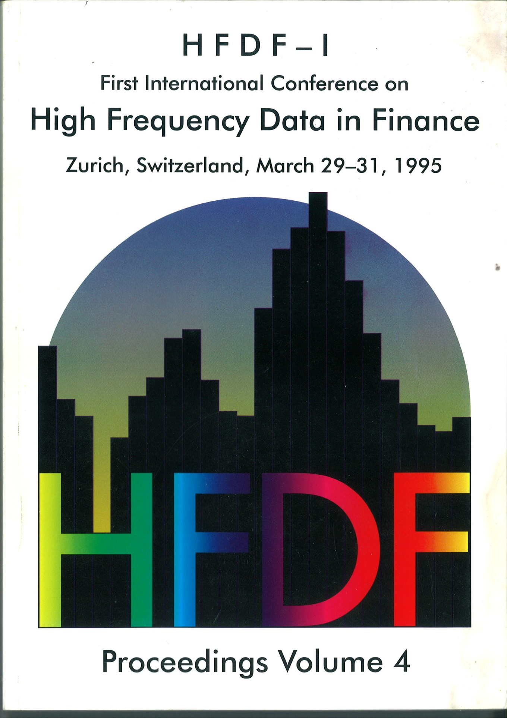

Slide 15
Algo In Use
In each market (2011 estimates, exchanges)
65 ~ 75% of NYSE is HFT
40% of LSE is HFT
35 ~ 70% of CME is algo
In each category (2012 forecast, Aite Group)
Equities 65%
Futures 47%
Options 39%
Forex 26%
Fixed Income 10%

Slide 16
Observation from order behavior
High Message Rate
Smaller Trade Size
High Order-to-Trade Ratio

Slide 17
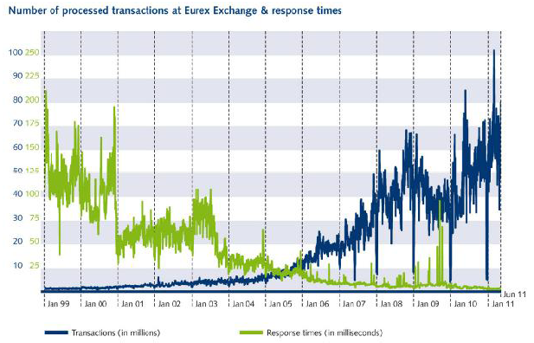
Continuous Growth of Messages
Quoted from “Eurex Exchange’s Trading System - Some insights into the details that matter for high frequency trading!” July 2011, W. Eholzer

Slide 18
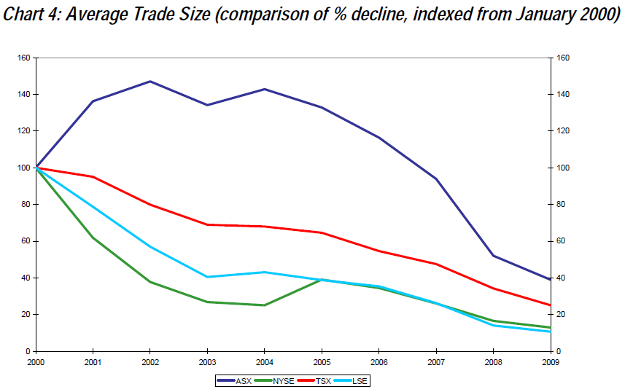
Smaller Trade Size
Quoted from ASX Review of “Algorithmic Trading and Market Access Arrangements” 8 February 2010
Notes:
NYSE (green) and LSE (light blue) 2009 trade sizes are only 15% of 2000.

Slide 19
High Order-to-Trade Ratio
Estimated 2010
NYSE 80:1
Nasdaq 100:1

Slide 20
Impact to market? Still controversial
Positive
Adding liquidity
Volume traded increased
Negative
Fairness concerns
Technical edge
Phantom orders
24 hour trading
Contributed to volatility of the market
The Flash Crash

Slide 21
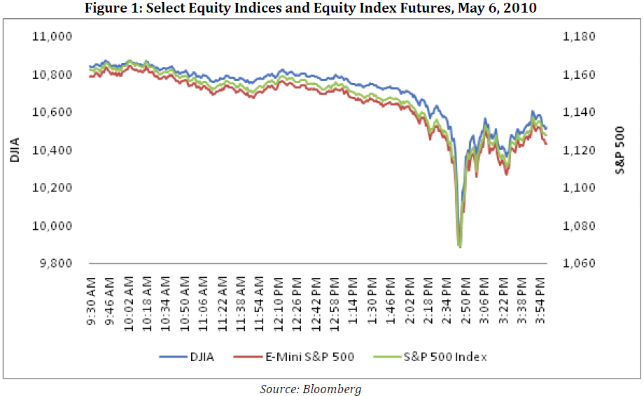
The Flash Crash
Quoted from “Preliminary Findings Regarding the Market Events of May 6, 2010”, Report of the Staffs of the CFTC and SEC to the Joint Advisory Committee on Emerging Regulatory Issues, May 18, 2010

Slide 22
A Brave New World
From Atomic Bomb to Algo Trade
Market Overview
Landscape
Algo Trading
Impact of Algo
Reaction from regulators and market participants
Facilitating
Regulating
Taiwan markets
Opportunities
Challenges
The Way Forward
Notes:
Suggested time distributed to each topic
Algo/market overview 5 min
Impact and flash crash 5 min
Reaction 10 min
Taiwan challenge/opportunity 5 min
Conclusion 5 min

Slide 23
Facilitating at the Exchanges
Strengthen Trading system
Low latency
Move to Linux for lower cost and fast expansion
Trading related IT services
DMA, Direct Market Access
Co-location
Direct, low latency and rich market data feed

Slide 24
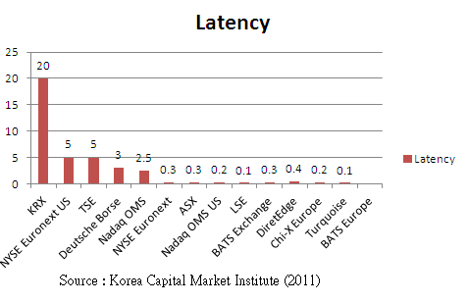
Latency Competition
Quoted from “EXTURE+ Trading System - Preparing for the coming era of Asian HFT”, Dae-Young Kim of KRX at Trading Architecture Asia 2011, September 8, 2011

Slide 25
DMA
Low Touch
No Touch
Electronic
orders
Client
System
Broker
Client
System
Broker
Route
To
Exchange
Drop
Copy
Electronic
orders
Exchange
Exchange

Slide 26
Co-Location
Distance matters
Light speed 300,000km/sec
= 300m/microsecond
= 30cm/nanosecond
Client or broker systems moving into exchange data center to reduce latency
Major exchanges provide co-location for revenue
Football fields size data center with equal cable length to exchange trading system from any racket

Slide 27
Facilities of Intermediaries
Standard connection protocol
FIX, Financial Information eXchange
Algo engine: insource/outsource
Smart order routing
Algo incorporated protocol
FIXatdl, FIX algo trading definition language

Slide 28
Any other that reduces latency
Low latency network/protocol
Infiniband
RDMA, Remote Direct Memory Access
Acceleration NIC driver
Multiple core servers
Trade in the box
FPGA, Field Programmable Gate Array

Slide 29
Cautious Responses from Regulators
Call for study of HFT
Circuit break
Risk management guideline
Co-Location guideline
Audit trail project
Cut from $4bn to $1bn
Postponed

Slide 30
Self-Protection at Exchanges
Circuit breaker or the likes
Fine run-wild algo (sudden, vast amount of error trades)
Fine stupid algo (extreme order-to-trade ratio)

Slide 31
A Brave New World
From Atomic Bomb to Algo Trade
Market Overview
Landscape
Algo Trading
Impact of Algo
Reaction from regulators and market participants
Facilitating
Regulating
Taiwan markets
Opportunities
Challenges
The Way Forward
Notes:
Suggested time distributed to each topic
Algo/market overview 5 min
Impact and flash crash 5 min
Reaction 10 min
Taiwan challenge/opportunity 5 min
Conclusion 5 min

Slide 32
Taiwan Market Practices
Cash
Intermittent call auctions
Limit orders only
35 millisecond latency (order confirmation)
Real-time “market data”
Low-touch DMA
Derivatives
Continuous auctions
Limit, Market, IOC, FOK, Cancel-After-20-Sec-Quote
800 microsecond latency
250ms 5BBO snapshots
Low-touch DMA

Slide 33
Taiwan Investor Distribution
By legal identity
Cash
65% individual
36% institutional
Derivatives
45% individual
55% institutional
By origin of funds
Cash
75% local
25% overseas
Derivatives
92% local
8% overseas

Slide 34
Taifex Message Traffic

Slide 35
Taifex Order-to-Trade Ratio

Slide 36
Taifex 2011 Updates
2011
 | Futures |  | Options
 | Non-Market Maker | Market Maker | Non-Market Maker | Market Maker
Number of Orders(new) | 220,748,187 | 85,843,624 | 181,201,730 | 496,143,888
Number of Contracts Traded(成交口數雙邊) | 109,568,633 | 3,176,337 | 131,401,020 | 121,844,352
Number of Trades(成交筆數,同一委託書編號算一筆) | 55,240,003 | 491,600 | 22,712,986 | 10,003,981
Order to Trade Ratio | 4.00 | 174.62 | 7.98 | 49.59

Slide 37
Potential Facilitating Actions
Low latency trading platform
Tick-by-tick and richer market data
No-touch DMA
Co-location
Algo testing platform
Common Algo engine for retails

Slide 38
Risk Control Measurement Needed
Sponsored Access
Pre-trade credit control managed by clearing members but implemented on exchange-side system for DMA investors
Circuit breaker
Audit trail analyzer

Slide 39
The Way Forward
If it were done when ‘tis done, then ‘twere well
It were done quickly:
Knowledge is power: redefine Market Quality etc
The importance of being Earnest: truth and honesty

Slide 40
Thank You
and
God bless you

